Slide 1
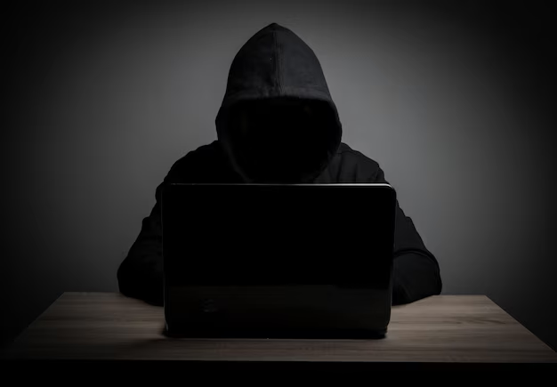
Phishing
Attack
What is Phishing?
Definition: a technique used by cyberattackers to attempt to gain sensitive information
Common Methods: Email, SMS (Text), Voice (vishing)
Goals: Obtain login credentials, sensitive information, financial information, infect devices
Notes:
Phishing Attack
Teams at Risk: HR & Marketing

Slide 2
Phishing
Attack
What is Phishing?
Definition: a technique used by hackers to attempt to gain sensitive information
Common Methods: Email, SMS (Text), Voice (vishing)
Goals: Obtain login credentials, sensitive information, financial information, infect devices
Notes:
Phishing Attack
Teams at Risk: HR & Marketing

Slide 3
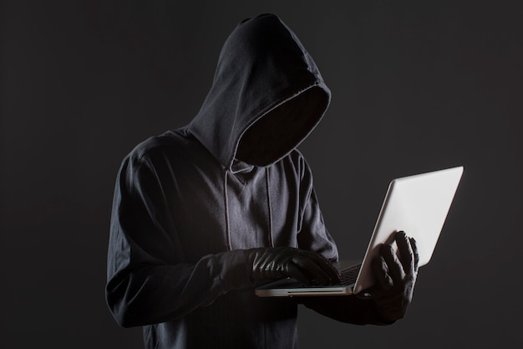
How to Spot Phishing Emails
Urgency!
Grammat1cal Mistak3s
Attachments.docx and File Extensions.pdf
Monetary Offers $
Requests for Credentials ?
Notes:
Recognize:
Urgency (time urgency, exclamation points, etc)
Grammatical Mistakes
Attachments and File Extensions
Monetary Offers
Request for Credentials

Slide 4
Spot the Phishing Email: Difficult
Subject: Important: Please Reset Your Password From: support@yourbank.com
Dear Customer,
We noticed unusual activity on your account and recommend resetting your password as a security measure. Please click the link below to securely reset your password:
Reset Password
If you did not request this, please ignore this email. We take your account security seriously.
Sincerely, Your Bank Support Team support@yourbank.com
Subject: Important: Please Reset Your Password From: support@yourbank.com
Dear Customer,
We noticed unusual activity on your account and recommend resetting your password as a security measure. Please click the link below to securely reset your password:
Reset Password
If you did not request this, please ignore this email. We take you’re account security seriously.
Sincerely, Your Bank Support Team support@yourbank.com
Notes:
How to Spot Phishing Emails
Recognize:
Urgency (time urgency, exclamation points, etc)
Grammatical Mistakes
Attachments and File Extensions
Monetary Offers
Request for Credentials

Slide 5
How do we stop getting phished?
Best Practices:
Check sender email address
Check grammar and spelling
Do not respond to requests for info or urgency
Use two-factor authentication when possible
Report suspicious emails to IT
“If you don’t know, don’t click!”

